Slide 1
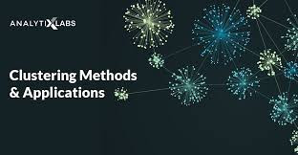
Exploring Clustering in Pattern Recognition
Presented by
Name – Aditya Kumar
Roll No. – 34230821034
Dept. – CSE(AI & ML)
3rd year (5th semester)
Future Institute of Technology

Slide 2
1. Introduction
Pattern recognition is a fundamental concept in machine learning. It involves identifying similarities and dissimilarities among data points.
Clustering is a popular technique used for pattern recognition. It groups data points into clusters based on their similarities.
It is basically a type of unsupervised learning method.
An unsupervised learning method is a method in which we draw references from datasets consisting of input data without labeled responses. Generally, it is used as a process to find meaningful structure, explanatory underlying processes, generative features, and groupings inherent in a set of examples.
This presentation explores various clustering algorithms and their applications in pattern recognition.
Aditya Kumar,34230821034

Slide 3
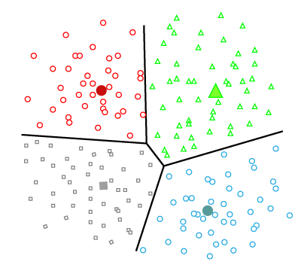
2. Overview of Clustering
Clustering is a unsupervised learning technique that aims to discover hidden patterns in data. It groups similar data points together and assigns them to clusters. The goal is to maximize intracluster similarity and minimize intercluster similarity..
Types of Clustering Methods
1.Partitioning Clustering-It is a type of clustering that divides the data into non-hierarchical groups. It is also known as the centroid-based method. The most common example of partitioning clustering is the K-Means Clustering algorithm.
In this type, the dataset is divided into a set of k groups, where K is used to define the number of pre-defined groups. The cluster center is created in such a way that the distance between the data points of one cluster is minimum as compared to another cluster centroid.
Aditya Kumar,34230821034

Slide 4
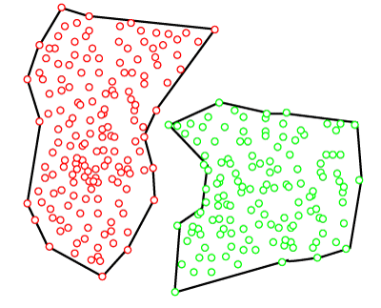
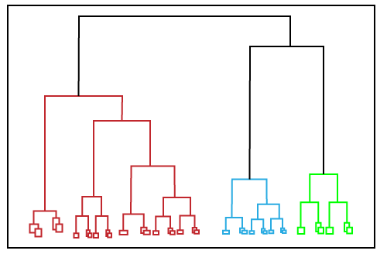
2. Density-Based Clustering - The density-based clustering method connects the highly-dense areas into clusters, and the arbitrarily shaped distributions are formed as long as the dense region can be connected. This algorithm does it by identifying different clusters in the dataset and connects the areas of high densities into clusters. The dense areas in data space are divided from each other by sparser areas. These algorithms can face difficulty in clustering the data points if the dataset has varying densities and high dimensions.
3. Hierarchical Clustering - Hierarchical clustering can be used as an alternative for the partitioned clustering as there is no requirement of pre-specifying the number of clusters to be created. In this technique, the dataset is divided into clusters to create a tree-like structure, which is also called a dendrogram. The observations or any number of clusters can be selected by cutting the tree at the correct level. The most common example of this method is the Agglomerative Hierarchical algorithm.
There are also other various approaches of clustering exists such as fuzzy clustering, distribution model based clustering, etc.
Aditya Kumar,34230821034

Slide 5
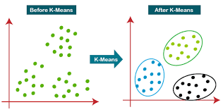
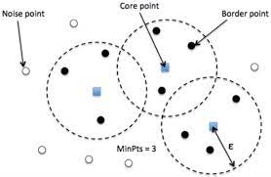
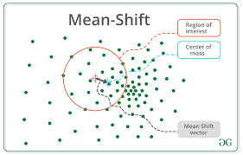
3. Clustering Algorithms
The Clustering algorithms can be divided based on their models that are explained above. There are different types of clustering algorithms published, but only a few are commonly used. The clustering algorithm is based on the kind of data that we are using. Such as, some algorithms need to guess the number of clusters in the given dataset, whereas some are required to find the minimum distance between the observation of the dataset.
1. K-means Clustering - K-means is a popular clustering algorithm. It partitions data
into K clusters by minimizing the sum of squared distances between data points and their
cluster centroids. The algorithm iteratively updates the centroids until convergence.
However, it requires specifying the number of clusters K in advance.
2. DBSCAN - DBSCAN (Density-Based Spatial Clustering of Applications with Noise) is a density-based clustering algorithm. It groups data points based on their density and connectivity. It can discover clusters of arbitrary shapes and handle noisy data. DBSCAN defines three types of data points: core points, border points, and noise points
3. Mean-shift algorithm: Mean-shift algorithm tries to find the dense areas in the smooth density of data points. It is an example of a centroid-based model, that works on updating the candidates for centroid to be the center of the points within a given region.
ADITYA KUMAR, 34230821034

Slide 6
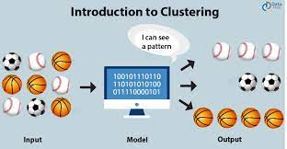
4.Real Life Example of Clustering
Let's understand the clustering technique with the real-world example of Mall: When we visit any shopping mall, we can observe that the things with similar usage are grouped together. Such as the t-shirts are grouped in one section, and trousers are at other sections, similarly, at vegetable sections, apples, bananas, Mangoes, etc., are grouped in separate sections, so that we can easily find out the things. The clustering technique also works in the same way. Other examples of clustering are grouping documents according to the topic.
Apart from these general usages, it is used by the Amazon in its recommendation system to provide the recommendations as per the past search of products.
Netflix also uses this technique to recommend the movies and web-series to its users as per the watch history.
Aditya Kumar,34230821034

Slide 7
5. Applications of Clustering
In Identification of Cancer Cells: The clustering algorithms are widely used for the identification of cancerous cells. It divides the cancerous and non-cancerous data sets into different groups.
In Search Engines: Search engines also work on the clustering technique. The search result appears based on the closest object to the search query. It does it by grouping similar data objects in one group that is far from the other dissimilar objects. The accurate result of a query depends on the quality of the clustering algorithm used.
Customer Segmentation: It is used in market research to segment the customers based on their choice and preferences.
In Biology: It is used in the biology stream to classify different species of plants and animals using the image recognition technique.
In Land Use: The clustering technique is used in identifying the area of similar lands use in the GIS database. This can be very useful to find that for what purpose the particular land should be used, that means for which purpose it is more suitable.
Aditya Kumar,34230821034

Slide 8
6. Conclusion
Clustering is a powerful technique for pattern recognition. It helps uncover underlying structures and relationships in data. By exploring different clustering algorithms like K-means, DBSCAN, and Hierarchical clustering, we can gain insights into complex patterns. Understanding clustering techniques enables us to solve real-world problems in various domains such as customer segmentation, image recognition, etc.
THANK YOU!
Aditya Kumar,34230821034

